Slide 1



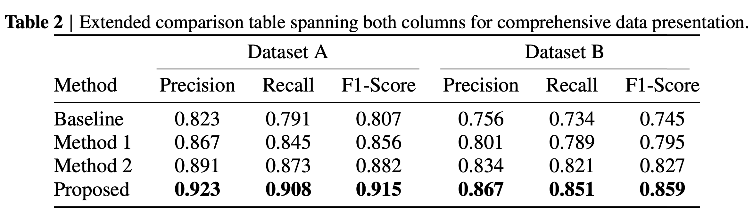
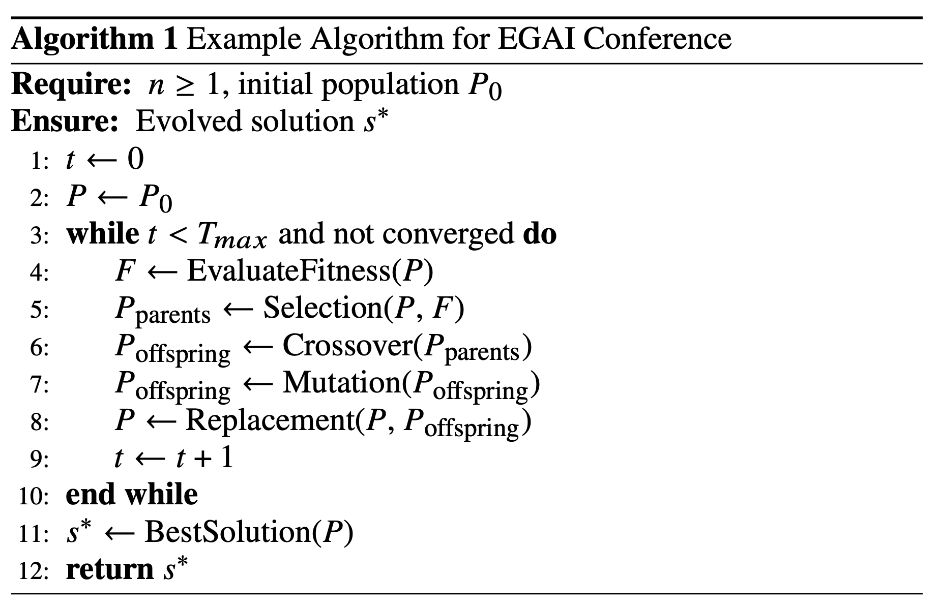

Place custom logo(s) & QR Code
Main Title of the Poster (55pt)
Author Name, Author Name, Author Name (25pt)
Affiliations, Emails (23pt)
Section Name in 35pt
Section Name in 35pt
Section Name in 35pt
Optional captions (20pt)
This template is designed for the 3rd International Conference on Evolutionary Game Theory and Artificial Intelligence (EGAI 2025). It serves as an official poster template to help participants present their research in a clear, professional, and visually coherent format. The template follows a three-column layout, suitable for organizing content.
Subsection Name in 30pt
This template is designed for the 3rd International Conference on Evolutionary Game Theory and Artificial Intelligence (EGAI 2025). It serves as an official poster template to help participants present their research in a clear, professional, and visually coherent format. The template follows a three-column layout, suitable for organizing content.
Optional captions (20pt)
This template is designed for the 3rd International Conference on Evolutionary Game Theory and Artificial Intelligence (EGAI 2025). It serves as an official poster template to help participants present their research in a clear, professional, and visually coherent format. The template follows a three-column layout, suitable for organizing content.
This template is designed for the 3rd International Conference on Evolutionary Game Theory and Artificial Intelligence (EGAI 2025). It serves as an official poster template to help participants present their research in a clear, professional, and visually coherent format. The template follows a three-column layout, suitable for organizing content.
Subsection Name in 30pt
Section Name in 35pt
$${\dot{x}}_{i}={\dot{x}}_{i}\left(f_{i}−\sum_{j}{x_{j}f_{j}}\right)$$
Subsection Name in 30pt
Addendum & References
Name: Hangzhou International Innovation Institute (H3I) of Beihang University
Address: No. 166, Shuanghongqiao Street, Pingyao Town, Yuhang District, Hangzhou, Zhejiang, China
Website: https://h3i.buaa.edu.cn/
The Code is available at https://egai.cc/
Subsection Name in 30pt
1. Campbell, S. L. & Gear, C. W. The index of general nonlinear DAES. Numer. Math. 72,
173–196 (1995).
2. Slifka, M. K. & Whitton, J. L. Clinical implications of dysregulated cytokine production. J.
Mol. Med. 78, 74–80 (2000).
3. Hamburger, C. Quasimonotonicity, regularity and duality for nonlinear systems of partial
differential equations. Ann. Mat. Pura. Appl. 169, 321–354 (1995).
4. Geddes, K. O., Czapor, S. R. & Labahn, G. Algorithms for Computer Algebra (Kluwer,
Boston, 1992).
Name: Hangzhou International Innovation Institute (H3I) of Beihang University
Address: No. 166, Shuanghongqiao Street, Pingyao Town, Yuhang District, Hangzhou, Zhejiang, China
Website: https://h3i.buaa.edu.cn/
Optional captions (20pt)

Slide 2
Color Palette
#ffffff | #f2f7f5 | #c1dcd3 | #7dab9c | #367474
#ffffff | #fff8f6 | #faf0e7 | #da736f | #333333
#ffffff | #f2f7ff | #a1b4d7 | #3e5bb2 | #333333
#ffffff | #e3e3ff | #a2a2c5 | #7e7ebb | #47496d

